Slide 1
Unit 5-5
Inequalities in Triangles
PLANE Geometry

Slide 2



Angle-Side Relationships in a Triangle:
If two sides of a triangle are not congruent, then the larger angle lies opposite the longer side.
$$If XZ>XY, then m∠Y>m∠Z.$$
$$Y$$
$$X$$
$$Z$$

Slide 3











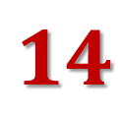
Example 1:
Order the Angles from Least to Greatest.
$$Y$$
$$B$$
$$7$$
$$12$$
$$18$$
$$A$$
$$5$$
$$X$$
$$Z$$
$$3$$
$$14$$
$$C$$

Slide 4



Angle-Side Relationships in a Triangle:
If two angles of a triangle are not congruent, then the longer side lies opposite the larger angle.
$$If m∠A>m∠B, then BC>AC.$$
$$B$$
$$A$$
$$C$$

Slide 5
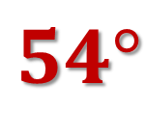
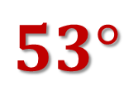

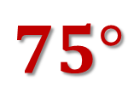
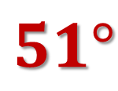
Example 2:
Order the Sides from Least to Greatest.
$$Y$$
$$B$$
$$53°$$
$$54°$$
$$A$$
$$87°$$
$$75°$$
$$51°$$
$$X$$
$$Z$$
$$C$$

Slide 6



Triangle Inequality Theorem:
The sum of the lengths of any two sides of a triangle is greater than the length of the third side.
$$Y$$
$$X$$
$$Z$$

Slide 7



Example 3:
Can a Triangle have Sides with the Given Lengths?
$$4,7,10$$
$$8,14,20$$
$$2,3,5$$

Slide 8



Example 4:
The lengths of two sides of a triangle are given. Describe the lengths possible for the thirds side.
$$8,12$$
$$4,22$$
$$13,45$$

